Slide 1
Project Discussion
7th March 2025

Slide 2
1. Data Annotation & Setup (Completed) | Pre-March 1 | Annotate all chart elements (X & Y Axes, ticks, axis titles, data point labels, legends, plotting areas) | 2
 |  | Prepare and organize the dataset for training (include varied examples for Pie, Bar, and Line charts) | 2
2. YOLO Training (Completed) | Pre-March 1 | Train YOLO to detect annotated chart elements | 2
 |  | Validate YOLO performance on diverse chart samples | 2
 |  | Adjust training parameters based on early results | 2
3. Initial Axis Recognition Model (Completed) | Pre-March 1 | Develop a rough model for identifying axis elements (ticks, axis titles, etc.) | 2
 |  | Generate initial mappings between detected ticks and axis labels | 2
4. OCR Integration using PaddleOCR | March 1 – March 7 | Set up the PaddleOCR environment and install dependencies | 2
 |  | Crop out detected chart elements (from YOLO output) for OCR processing | 2
 |  | Run PaddleOCR on these cropped images to extract text and numbers | 2
 |  | Validate OCR outputs and refine image preprocessing (resizing, contrast adjustments, etc.) | 2
6. Data Point to Axis Mapping | March 8 – March 14 | Extract data point coordinates from YOLO outputs | 1
 |  | Determine axis boundaries by comparing min/max x-coordinates from both ticks and data points
 |  | Calculate the pixel interval based on the number of data points | 1
 |  | Interpolate missing tick positions for Y Axis
 |  | Interpolate missing tick positions for X Axis
 |  | Map each data point to its corresponding axis value using the computed intervals
 |  | Implement error handling for missing or misdetected axis elements

Slide 3
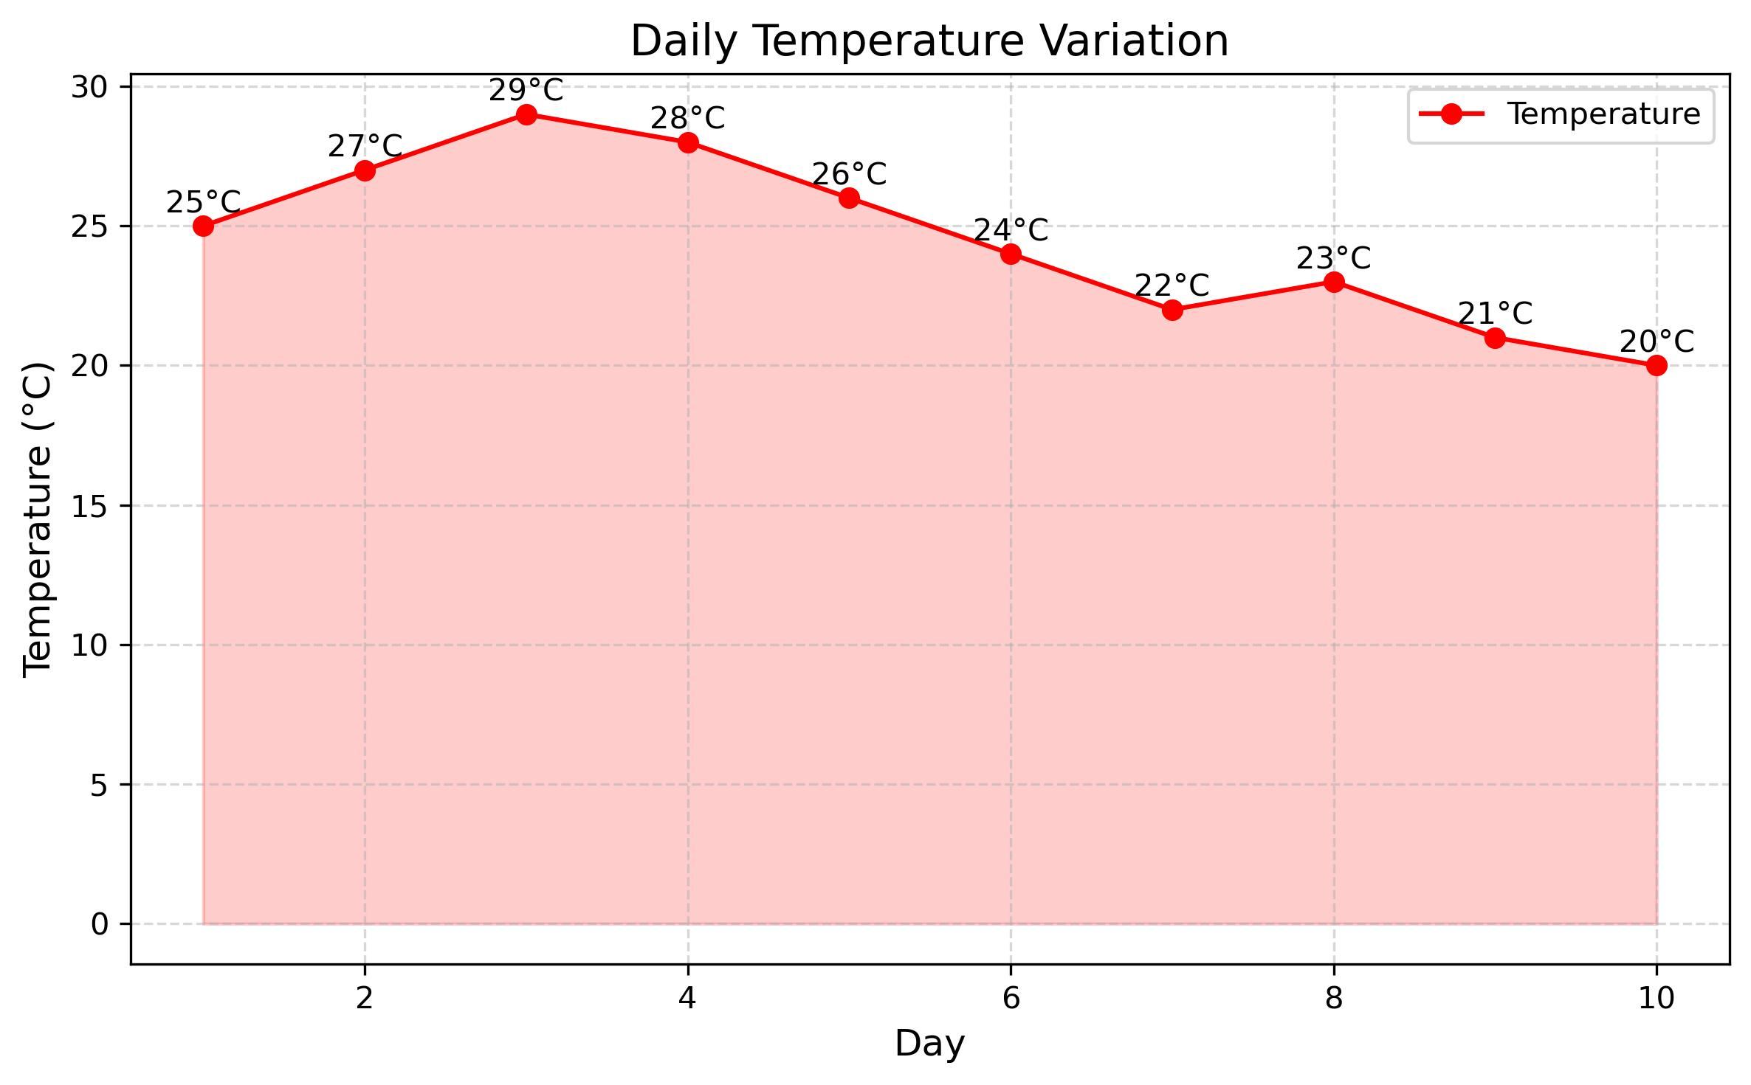

Slide 4
Figuring Out X Axis Coordinates
Tried figuring out the number of Data Point Labels, compared it to number of X Axis Ticks, if less we went to the next steps
Figured out which came first the Data Point Label or X Axis Tick, based on the pixel value
Based on the number of X Axis Ticks and Data Point Labels, figured out the number of ticks, and the distance between each tick, and then interpolated the X Axis Tick coordinate

Slide 5
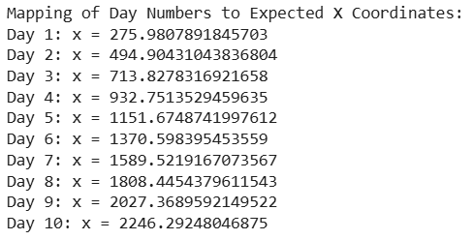

Slide 6
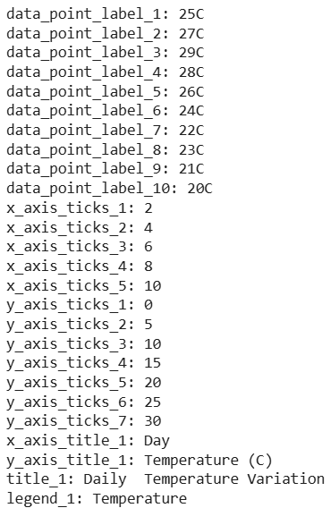
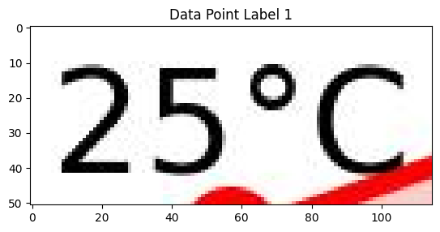
PaddleOCR

Slide 7
Next Steps
Filling in missing X Axis values using Text-to-Text Transfer Transformer (T5)
Interpolating Y Axis Values by using minimum and maximum Y Axis Ticks and Pixel values
Identifying Data Point using edge detection methods
Plotting the identified Data points on the Y Axis and identifying their value based on the interpolated Y Axis values

Slide 8
What is T5?
T5 is a deep learning model developed by Google AI in 2019.
It converts all NLP tasks into a text-to-text format, making it highly versatile.
The model is based on the Transformer architecture, similar to BERT and GPT.
It undergoes pre-training by predicting missing text in large datasets.
Fine-tuning allows it to specialize in tasks like translation, summarization, and classification.
T5 is available in different sizes, ranging from 60 million to 11 billion parameters.
Its unified approach and scalability have influenced many modern NLP models.
https://huggingface.co/docs/transformers/en/model_doc/t5

Slide 9
MoM
Update Roadmap: Pivot Table
Multiple examples of Line Chart Bar Chart Pie Chart, with OCR and T5 outputs
How OCR & T5 work: 1 sliders; explain in high level

